Slide 1
Hi! Please check-In in the chat as we admit people! Use a different color heart emoji or type in the phrase.

Slide 2
WELCOME BROOKLYN
CUNY EDGE NEW STUDENTS
FALL 2020 ORIENTATION
Notes:
Monique

Slide 3
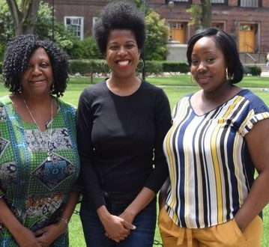
Program Personnel
Monique Ngozi Nri, M.Sc.
Program Director
Roberte Lescouflair, M.Ed.
Senior Program Advisor
Jaclyn Hodge, B.S.
Program Coordinator/Fellowship Assistant
Student Office Assistants
Selena Torres
Vanessa Jenkins
Deijha Blake
Notes:
ALL

Slide 4
Brooklyn CE Orientation Agenda Fall 2020
Welcome & Staff Introductions
Our Mission and Goals for Fall 2020
HRA Engagement Policy
HRA Access
Academic: Advisement, Scholarships and Incentives
Professional: HRA Fellowship recommendations and HRA fellowship positions turning into employment for students
Personal: parent support groups, mindfulness workshops, counseling referrals; learning center; library introductions; first generation students
Notes:
Monique

Slide 5
Brooklyn CE Orientation Agenda Fall 2020 (cont)
Review of academic calendar
Workshop Review
September Workshops/Survey
Form Completion
Review FIA request form online
Complete workshop survey
Complete Evaluation
Notes:
Monique

Slide 6
CUNY EDGE envisions a world in which all people have access to the educational opportunities and supports they need to realize academic success, a sustainable career, and a brighter future. We commit to contributing to this vision.
CUNY EDGE’s mission is to help CUNY students who are receiving public assistance achieve academic excellence, graduate on time, and find employment.
Notes:
Monique

Slide 7
Brooklyn CE Mission and Goals For Fall 2020
None of us signed up for this … Compassion, humanity, support
Assistance with COVID related issues and resources
Communicate effectively virtually
HRA and Brooklyn College Policy Updates
Notes:
Monique

Slide 8
CUNY EDGE Components
CUNY EDGE
HRA Related Matters
Referrals
Engagement
HRA Fellowship Program
Career Support Services
Advisement/
Support Services
Notes:
MS SONE

Slide 9
Human Resources Administration (HRA)
Student Participation
12-Month Lifetime Training
30-Hours-Weekly
25-Hours-Weekly (< 5-years old)
Approved Activities
Homework (supervised/unsupervised)
Internship (paid/unpaid)
Externship (paid/unpaid)
Federal Work-Study (FWS)
HRA Fellowship (paid)
Paid Employment
Notes:
Monique

Slide 10
CUNY EDGE Overview
Funded by and operated in collaboration with the Family Independence Administration of the City of New York Human Resources Administration (HRA)
Provides academic and career support services to students receiving public assistance
Notes:
Monique

Slide 11
HRA Compliance
Submission to CUNY EDGE
FIA Enrollment Letter
Absence Documentation
Timesheets (if applicable)
If Engaged in other activities
Completed Assignment Verification Form:
Federal Work Study
Internship
Externship
Supervised Homework
Notes:
Monique

Slide 12
Engagement
Monthly
Virtual Meeting with your CE Advisor
Video Conference, Phone, Email, Text
Attend a workshop
Notes:
Monique

Slide 13
ACCESS HRA
It’s HRA’s online portal
Apply online for Supplemental Nutrition Assistance Program
Recertification
Cash Assistance
Medicaid renewal
Manage your benefits online
Read agency notices
Budget Letter
Case(s) status
EBT balance
Recent payments
Upcoming appointments
Documents on file
And many more!
Notes:
Monique

Slide 14
Access HRA Cont.
ACCESS HRA Portal Home Page:
https://a069-access.nyc.gov/ACCESSNYC/application.do
ACCESS HRA Mobile:
Looking for the ACCESS HRA mobile app?
It's free on iOS or Android devices:
To download the app:
Go to the App Store or Google Play
Search for “ACCESS HRA”
Click on GET or INSTALL
Notes:
Monique

Slide 15
Academic Support Advising Partnership Responsibilities
As Advisors, “WE” …
Assist in helping you to find academic information
Refer you to other services (CAAS, Career Services, Veterans office, The Learning Center, Disability Services and more)
Help you to explore your interests, abilities, goals
Monitor your progress
Assist in helping you to learn how to make academic decisions
Notes:
Roberte

Slide 16
Advising Partnership Responsibilities (cont.)
What “WE” expect from you…
To take the initiative to contact us
Not to miss deadlines
To know when to register
To consult your academic advisors, your financial aid advisor and CE before you drop or add classes
To know the academic standards, policies and procedures that effect major requirements.(Academic Alert, Probation, Dismissal, Cumulative GPA, Honors)
Familiarity with the requirements of your major(s)
To develop an understanding of your course selection, and academic/career goals
Notes:
Roberte

Slide 17
Tips To Succeeding In College during COVID-19
Seek out help when you need it
Take advantage of all tutoring and Magner Career Center
Plan ahead!! Organize
Set goals
Recognize when you need help
Make smart decisions
Notes:
Roberte

Slide 18
Scholarships
MITSUI
Brooklyn College Scholarships
CUNY EDGE Scholarships
Notes:
Roberte

Slide 19
HRA Fellowship Program
“Helps YOU achieve your educational goals”
Approved by HRA- Opportunity
Register all eligible college activities with HRA (FIA Letter)
Virtual On-Campus Placements
Resume Required
Notes:
Jaclyn

Slide 20
Professional Services
Ensure your employment info/resume are updated
Participate in career-related events (professional development, networking, etc.)
Forward students towards career-enhancing opportunities through the Magner Career Center
Graduate Network with a feasible employment plan/goal
Notes:
Jaclyn

Slide 21
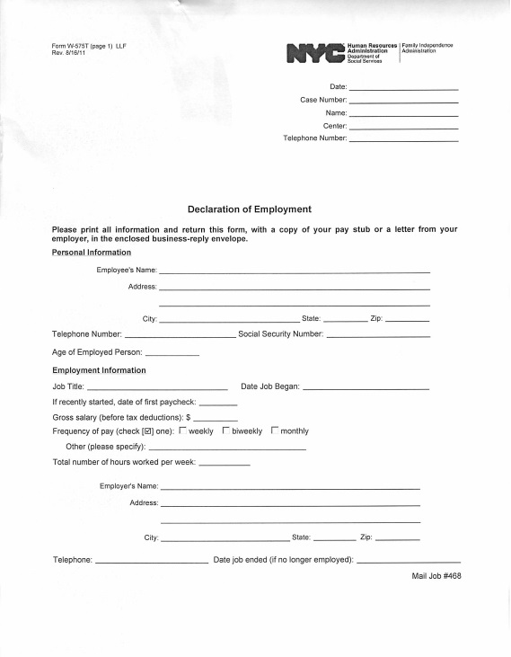
Declaration Of Employment
Let us know if you are working(other than HRA Fellowship Program)
We can help you fill out the form, if needed
Notes:
Jaclyn

Slide 22
Important dates to remember
Breaks and Final exams
Semester begins: August 26th
College Closed Monday September 7th Labor Day
Major declaration reopens for FA 20/SP21: November 6th
End of term: December 20th
LAST DAY:
To file an e-permit request: August 25th
To add a course: September 1st
To drop a course for 75% tuition refund: September 1st
To declare major for FA 20: September 11th
To file for FA 20 and Winter 21 graduation: September 15th
To withdraw course with W grade: November 6th
Much more could be found in the Fall 2020 College academic calendar
http://www.brooklyn.cuny.edu/web/about/administration/enrollment/registrar/bulletins/fall20/calendar.php
Notes:
Monique

Slide 23
CUNY EDGE Fall Workshop Calendar
09/10/2020: Welcome Back Event. Get program updates and meet with advisors from Financial Aid, Personal Counseling, Careers, and more! 12:00pm to 2:00pm. Zoom Location.
9/15/2020: Black Lives Matter Discussion. Join us for a discussion on the black lives matter movement and the impact of recent events 12:30pm to 2:00pm. Zoom Location.
09/17/2020: Financial Literacy. Learn the basics about financial literacy, tips to build wealth, build good credit, and choose the institution that fit for your financial needs. 12:30pm to 2:00pm. Zoom Location.
09/22/2020: Get That Scholarship. Learn more about the numerous scholarships available and application strategies from CUNY Edge students. 12:30pm to 2:00pm. Zoom Location.
Notes:
Roberte

Slide 24
CUNY EDGE Reoccurring Workshops:
Parent Support Group: 1st Tuesday of every month starting September 8th until December 1st, 2020. 1:00pm to 2:00pm. Zoom Location.
Graduate Support Group: September 24th, October 29th, November 24th, and December 10th. 2:00pm to 3:00pm. Zoom Location.
Monthly Birthday Celebration: September 24th, October 29th, November 24th, and December 10th. 1:00pm to 2:00pm. Zoom Location.
Notes:
Roberte

Slide 25
Contact Your CUNY EDGE Advisor To Make An Appointment
Monique Ngozi Nri
CUNY EDGE Program Director
(718)-951-5067
Email: Monique.Nri@Brooklyn.cuny.edu
Roberte Lescouflair
CUNY EDGE Senior Program Advisor
(718)-951-5067
*Schedule advisement appt: Calendly.com/Roberte-les
Email: Roberte.Lescouflair@Brooklyn.cuny.edu
Jaclyn Hodge
CUNY EDGE Program Coordinator/Fellowship Assistant
(718)-951-5067
E-mail:Jaclyn.Hodge@Brooklyn.Cuny.edu
If you have any questions or need help, please do not hesitate to contact us at 718-95 15067 or email us at CUNYEDGE@Brooklyn.cuny.edu
Notes:
Monique

Slide 26
Student Quiz

Slide 27
Workshop Survey
PLEASE FILL OUT THE CUNY EDGE WORKSHOP SURVEY!
https://www.surveymonkey.com/r/CGP7TQR
Notes:
Monique

Slide 28
Self Assessment Form

Slide 29
Student Contract

Slide 30
Evaluation Form and Student Contract
PLEASE FILL OUT THE CUNY EDGE ORIENTATION EVALUATION FORM AND YOUR STUDENT CONTRACT!
We will email them to you shortly!
Notes:
Monique

Slide 31
ON BEHALF OF THE BROOKLYN CUNY EDGE TEAM WE THANK YOU
Monique, Roberte, Jaclyn
Notes:
Monique

Slide 32
Notes:
Monique

